Slide 1
The Laramide Orogeny: What Were the Driving Forces?
Joseph M. English and Stephen T. Johnston
2004
Presentation by James McNeil

Slide 2
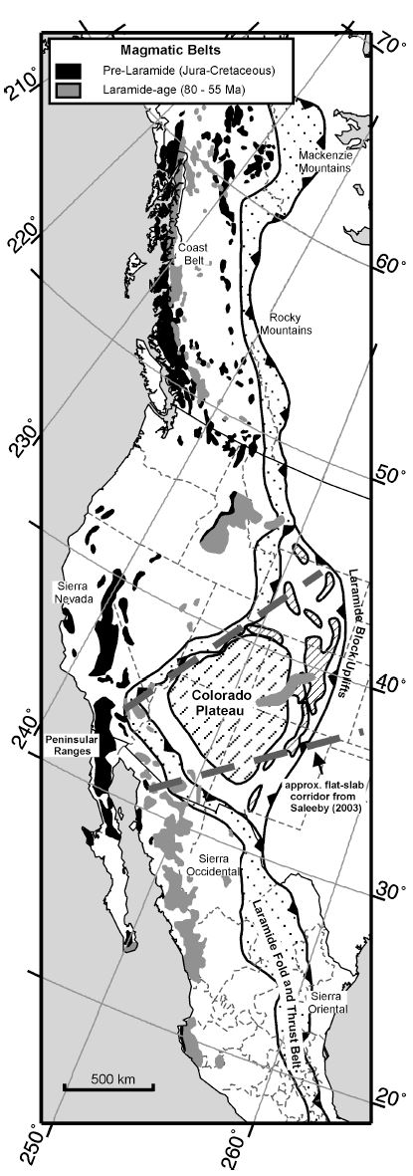
Introduction
Laramide Orogeny – Late Cretaceous to Paleocene (80-55 Ma) thin-skinned fold-and-thrust belt and thick-skinned block uplifts
Laramide block uplifts in the US
Rocky Mountain fold –and-thrust belt in Canada and US
Sierra Madre Oriental fold-and-thrust belt in east-central Mexico
Deformation belt developed 700-1500 km inland of plate margin
This paper: A review of proposed mechanisms for producing observed Laramide deformation
“The processes responsible for orgoeny remain enigmatic”
Proposed mechanisms:
Retroarc thrusting
“Orogenic float” tectonics
Flat-slab subduction
Cordilleran transpressional collision

Slide 3
Retroarc Thrusting (Price, 1981)
The rate of western advancement of NA plate exceeds the rate of slab rollback
The continent “collides” with the oceanic slab because it is unable to override the slab
Continental-scale mechanism
Variations in deformational style along strike could be produced by variations in crustal heterogeneity
Stress in the upper plate must be distributed across the entire Cordillera without causing significant deformation within orogen
Model doesn’t explain how shortening is accommodated in the mantle lithosphere

Slide 4
“Orogenic Float” Tectonics (Oldow et al., 1990)
Faults in the foreland are linked to a collision zone at the plate boundary by a major deep-crustal basal detachment
Entire crustal section “floats” on the underlying lithosphere
No development of a lithospheric root
No present driving force exists to apply a horizontal compressive stress above the proposed deep-crustal basal detachment
This model does not fit with the Laramide orogeny

Slide 5
Flat-Slab Subduction (Coney and Reynolds, 1977; Dickinson and Snyder, 1978; Bird, 1988)
Oceanic subducting slab along western margin of North America remains in contact with the overriding plate >700 km inboard of the trench
Was proposed to have be formed due to subduction of the Kula-Farallon spreading center, or a buoyant oceanic plateau
Fold-and-thrust belt in Canada and Mexico must be attributed to some other process because of the presence of a magmatic arc within 300 km of the trench during the Laramide
Synchronous orogen-wide contractional deformation but different regional processes?

Slide 6
Cordilleran Transpressional Collision
Paleomagnetic studies of Cretaceous layered sedimentary and volcanic rocks within the orogen suggest that the Canadian Cordillera originated 2000-3000 km to the south between 85-55 Ma
Laramide possibly occurred in response to a right-lateral transpressional collision between North America and a north-migrating ‘ribbon’ continent
Possible offscraping of passive margin sediments during northward translation of ribbon continent
Absence of an inner Late Cretaceous magmatic arc sheds doubt on this model

Slide 7
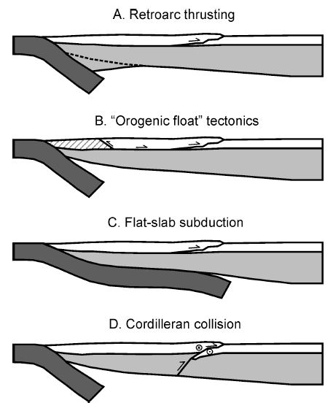
Discussion
Jarrard (1986) proposed four variables that determine the strain regime of the overriding plate at a converging margin
Convergence rate
Slab age
Intermediate slab dip-average dip to 100 km
Absolute motion of the upper plate
Unlikely that slab age, slab dip, or convergence rate were principle driving forces
Post-Laramide extension cannot be responsible for the location of the inland (700-1500 km) orogenic belt
Spreading rates weren’t abnormally high during Laramide

Slide 8
Discussion
Take home point: None of the proposed mechanisms for Laramide orogenesis explain the geometry, timing, or extent of the inboard continental scale orogeny.
3 questions:
1. Are the paleomagnetic data implying northward translation correct, and if so, how expansive was the Cordilleran entity that underwent >2000 km of northward translation during Laramide time?

Slide 9
Discussion
Take home point: None of the proposed mechanisms for Laramide orogenesis explain the geometry, timing, or extent of the inboard continental scale orogeny.
3 questions:
2. What was the relationship between northward translation, dextral transpression, and fold-and-thrust belt formation?
Does the fold-and-thrust belt represent the product of a collisional event following the closure of an intervening ocean basin, or does the fold and thrust belt root into an oblique dextral system that assisted in accommodating northward translation?

Slide 10
Discussion
Take home point: None of the proposed mechanisms for Laramide orogenesis explain the geometry, timing, or extent of the inboard continental scale orogeny.
3 questions:
3. Why did the Laramide strain zone form so far inboard (~1000 km) of the inferred plate boundary along the entire length of the continent?

